Slide 1



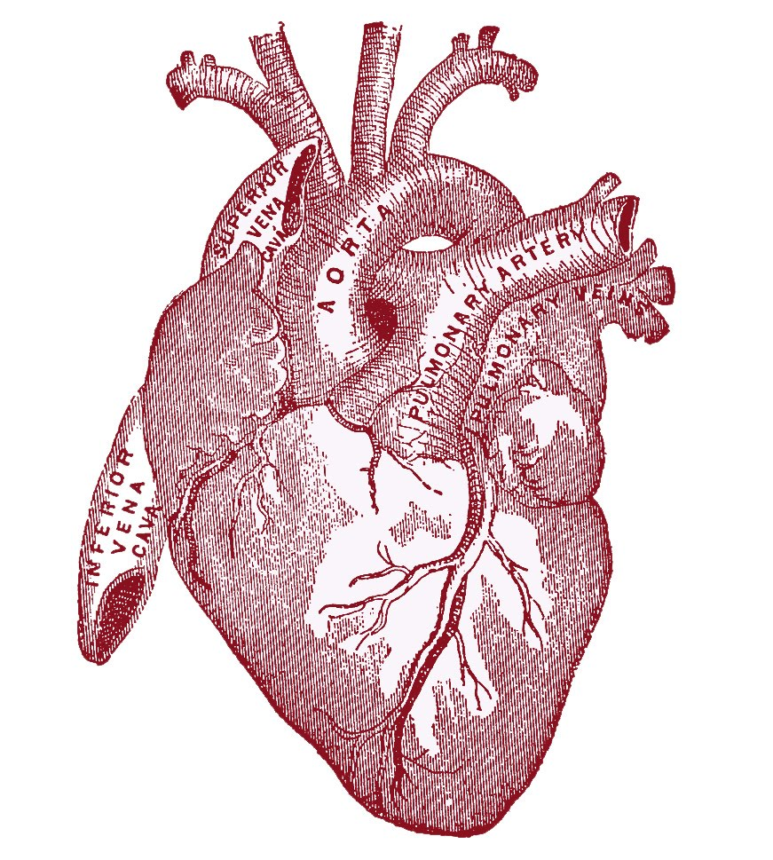
BIO BEAT
Team Bio beat:
Abdullah adeeb
Zachary cousins
Tejas patil
Drew gascoigne

Slide 2
What is Bio Beat?
It is a simple to use system that senses the user’s heart rate and the temperature of the environment.
Bio Beat sets the mood from collecting real-time data or from previous readings.
Bio Beat then uses the mood it has determined from the users information, in order to play music that enhances the experience.

Slide 3
How does Bio Beat work?
The user puts the pulse sensor on a finger and uses the GUI to adjust the settings to either collect data on command or periodically.
The temperature sensor will continuously be collecting data.
Some other settings could include type of environment, age and lifestyle.
Based on this information BIO BEAT will choose an appropriate song for your mood.

Slide 4
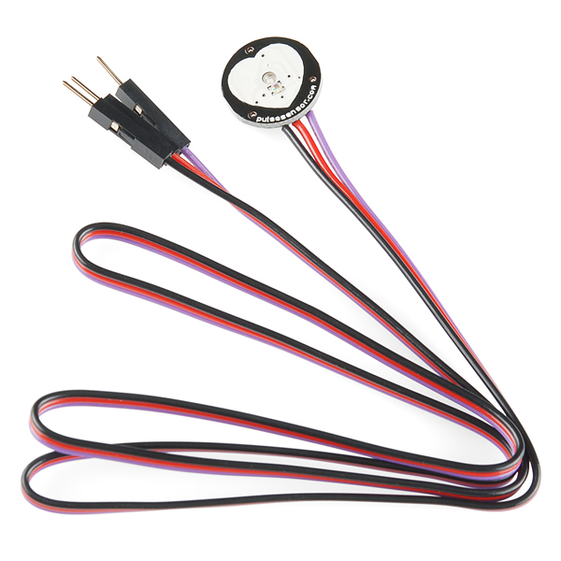

Heart beat monitoring

Slide 5
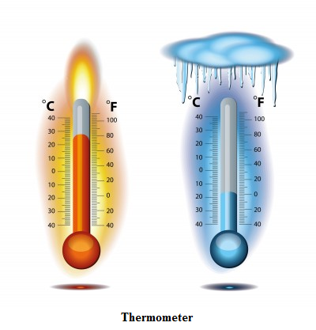

TEMPERATURE SENSING

Slide 6
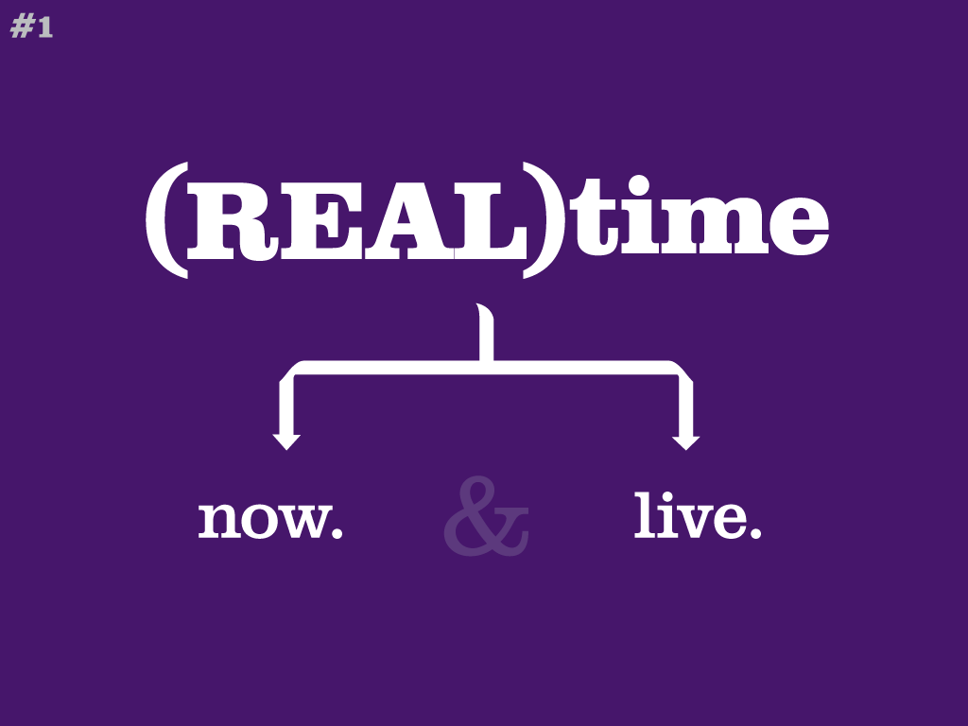
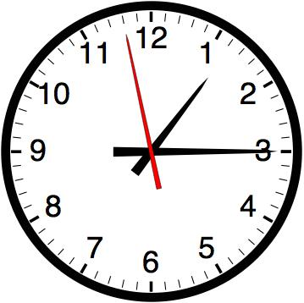
REAL TIME

Slide 7
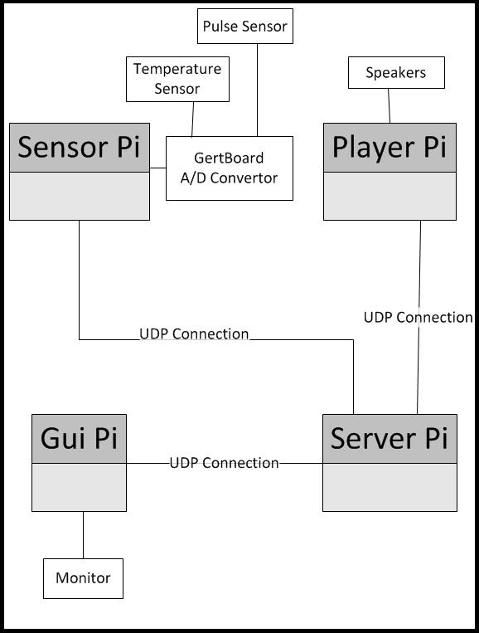
Top level architectural diagram

Slide 8
UML Class Diagrams
TemperaturePi | HeartbeatPi | DataTransmission
-int currentTemperature; | -int currentHeartbeat; | -DatagramSocket socket; -DatagramPacket sendPacket; -DatagramPacket receivePacket;
+void TemperaturePi(); +int getDigitalTemp(); +void getAnalogTemp(); | +void HeartbeatPi(); +int getDigitalHeartbeat(); +void getAnalogHeartbeat(); | +void DataTransmission(); +Boolean sendTransmission(); +Boolean receiveTransmission(); +DatagramPacket getData(); +Boolean ack(INetAddress IP);
Pi 1
This Pi board will be used to gather information from the user. Such as their temperature and their heartbeat.
StereoPi | LightPi | DataTransmission
+int songNum -String[] songs; -Final String[] mood; +int moodNum; | +int[] lights; -Final String[] mood; +int moodNum; | -DatagramSocket socket; -DatagramPacket sendPacket; -DatagramPacket receivePacket;
+void StereoPi(); +void fetchMood(); +void playSong(); +void nextSong(); +void previousSong(); +String returnNameOfSong(); -void parseSongs(); | +void LightPi(); +void fetchMood(); +void setLight(); | +void DataTransmission(); +Boolean sendTransmission(); +Boolean receiveTransmission(); +DatagramPacket getData(); +Boolean ack(INetAddress IP);
Pi 2
This Pi board will be used to display lights on the Piface, as well as play a song depending on the mood of the user.

Slide 9
UML CLASS DIAGRAMS
ServerPi | MoodAnalysis | DataTransmission
-DatagramSocket socket; -DatagramPacket sendPacket; -DatagramPacket receivePacket; | -Final String[] mood; -int temperature; -int heartbeat; | -DatagramSocket socket; -DatagramPacket sendPacket; -DatagramPacket receivePacket;
+void ServerPi(); +void echo(); | +void MoodAnalysis(); +void getTemperature(); +void getHeartbeat(); +int determineMood(); | +void DataTransmission(); +Boolean sendTransmission(); +Boolean receiveTransmission(); +DatagramPacket getData(); +Boolean ack(INetAddress IP);
Pi 3
This Pi Board will be used as the main server of the project. This board will provide mood analysis based off of the temperature and heartbeat. As well as send commands to all of the piboards.
Model | View | Controller | DataTransmission
 | +JLabel BackgroundMood; +Container gui; +JButton[] options; |  | -DatagramSocket socket; -DatagramPacket sendPacket; -DatagramPacket receivePacket;
+void Model(); +void buttonHandler (int buttonNum); +int getHeartbeat(); +int getTemperature(); +String getSong(); | +void View(); +void ActionPerformed (ActionEvent e); +void initGui(); | +void Controller(); +void doAction(ActionEvent e); | +void DataTransmission(); +Boolean sendTransmission(); +Boolean receiveTransmission(); +DatagramPacket getData(); +Boolean ack(INetAddress IP);
Pi 4
This Pi board will be used to display the GUI. It will also provide the user with buttons such as, next song, pause, play, etc..

Slide 10
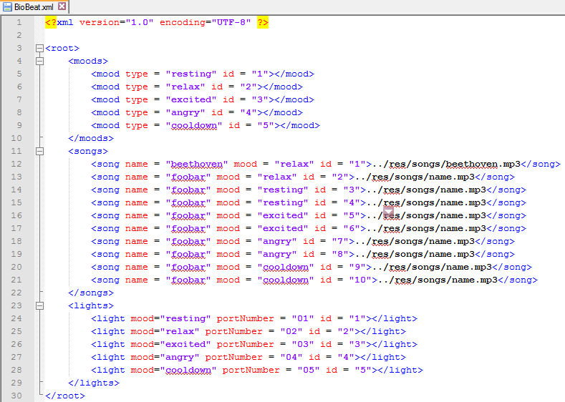
XML File structure
All the mood types and elements mood relations are stored in the XML file.

Slide 11
THE SYSTEM TEST PLAN ABSTRACT
BioBeat
System
Tests
Sensors
Analysis
Response
Communication
- Send a UDP message to each pi and validate acknowledgment message response.
- Send several simulated heart beats and temperatures then validate the mood.
- Simulate and send several moods and validate the correct songs being played
Test if the temperature/heart beat is within an acceptable range.
Test if change in the heart beat in one second is acceptable.

Slide 12
MILESTONES
Task Description | Duration (in weeks) | Preparation start | Due Date
Milestone 1: Design Review Presentation | 1 | Week of October 14, 2013 | 21 October 2013
Milestone 2: Establish and Test UDP communication | 2.5 | Week of October 21, 2013 | 18 November , 2013
Milestone 3: Implement and Test Sensors’ Handlers | 1.5 | Week of November11, 2013 | 21 November 2013
Milestone 4: Design, Implement and Test GUI | 1 | Week of November 18, 2013 | 25 November 2013
Milestone 5: UAT and Final Presentation | 1 | Week of November 25, 2013 | 4 December 2013

Slide 13
Potential Challenges

Slide 14
Thank You. Questions?

